Slide 1

IST615-Cloud Management
Group Members
Aditya Kini
Akshay Sigar
Parth Lodaria
Rahul Wable
Saheb Singh
Entra
A Smart Door System

Slide 2
Business Idea
Providing a secure and smart door system at an affordable cost wherein the owner can use the system to identify the guest and allow access accordingly using Alexa.

Slide 3
Scope
The scope of the project is to provide a smart secure door system for personal and corporate usage. The scope is not only limited to security but to maintain COVID-19 protocols ( For example: If a student has not taken the COVID-19 test and is trying to enter a building on the campus, he/she would be prohibited from entering the building by our system).

Slide 4
Competitor Analysis
Ring Door Lock System
Company charges both for the lock system as well as the subscription service but we only charge a subscription fees for our services, therefore we are cost efficient.
Ring shares information with third-parties like Google and Facebook which generates data privacy concerns. Unlike Ring we do not share any information with any other third-parties.
Arlo Video Door lock system
Additional services such as smart notification requires subscription. While these additional services are included in our monthly fee.
Arlo provides only battery-operated device. While we provide both battery powered and AC powered device according to customer requirements.

Slide 5
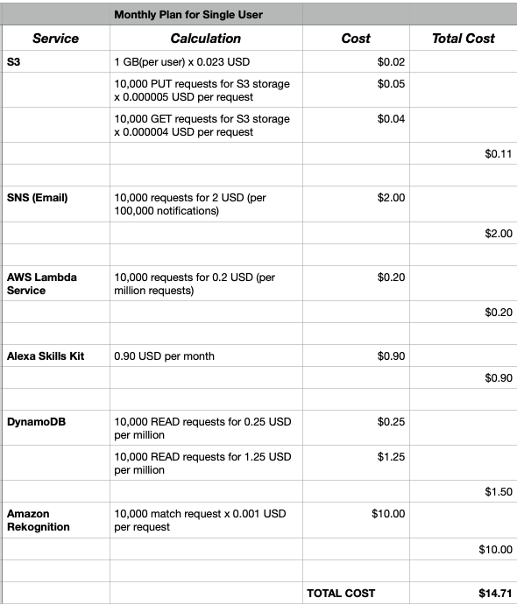
Cost Model – Home User (Monthly)
Profit: $29.99(Subscription Cost) - $14.71 = $15.21

Slide 6
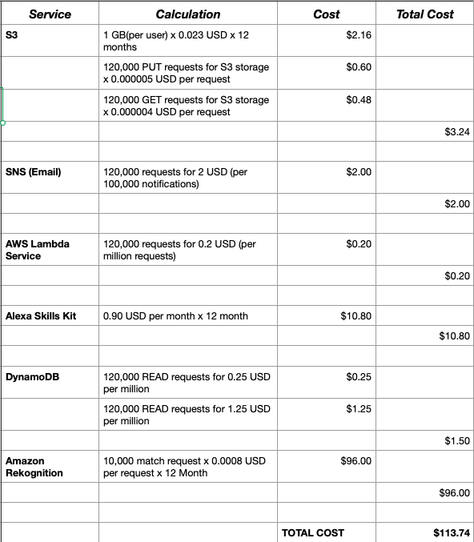
Cost Model – Home User (Annual)
Profit: $289.99(Subscription Cost) - $113.74 = $176.25

Slide 7
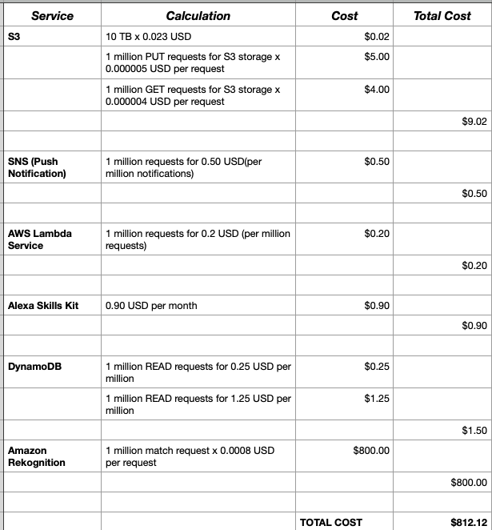
Cost Model –Corporate User (Monthly)
Profit: $1,199.99(Subscription Cost) - $812.12 = $387.87

Slide 8
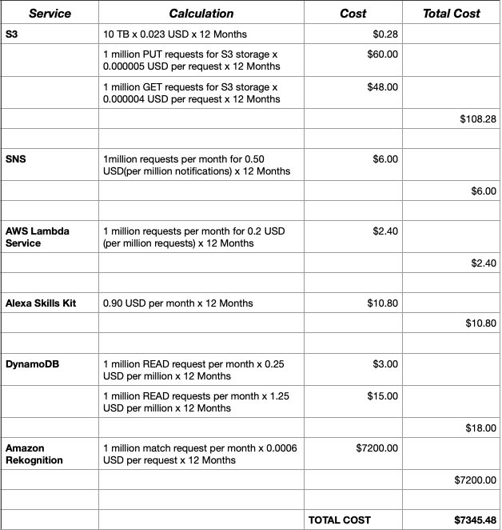
Cost Model –Corporate User (Annual)
Profit: $10,199.99(Subscription Cost) - $7345.48 = $2854.51

Slide 9
Revenue Model
Home Users
Monthly fees per user- $29.99
Number of expected subscriptions monthly- 100
Monthly revenue based on assumptions- $2,999
Monthly profit based on assumptions- $1,521
Annual fees per user- $289.99
Number of expected subscriptions annually- 100
Annual revenue based on assumptions- $28,999
Annual profit based on assumptions- $17,625
Corporate Users
Monthly fees per corporations- $1,199.99
Number of expected subscriptions monthly- 10
Monthly revenue based on assumptions- $11,999.9
Monthly profit based on assumptions- $3,878.7
Annual fees per corporations- $10,199.99
Number of expected subscriptions annually- 10
Annual revenue based on assumptions- $1,01,999.9
Annual profit based on assumptions- $28,545.1

Slide 10


Stakeholders
Stakeholders: People who would be interested in or affected by our product
Our company's Employees:
Information Technology Department
Finance Department
Sales Department
Clients
Private Clients (Home usage)
Corporate Clients

Slide 11
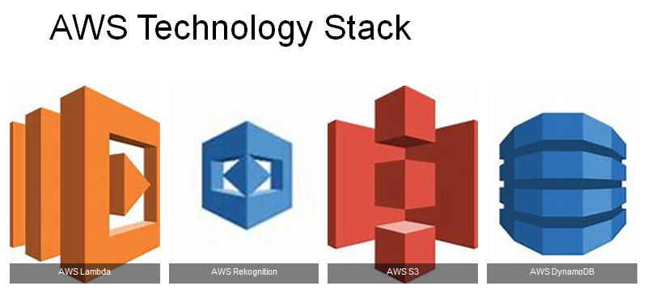

Slide 12
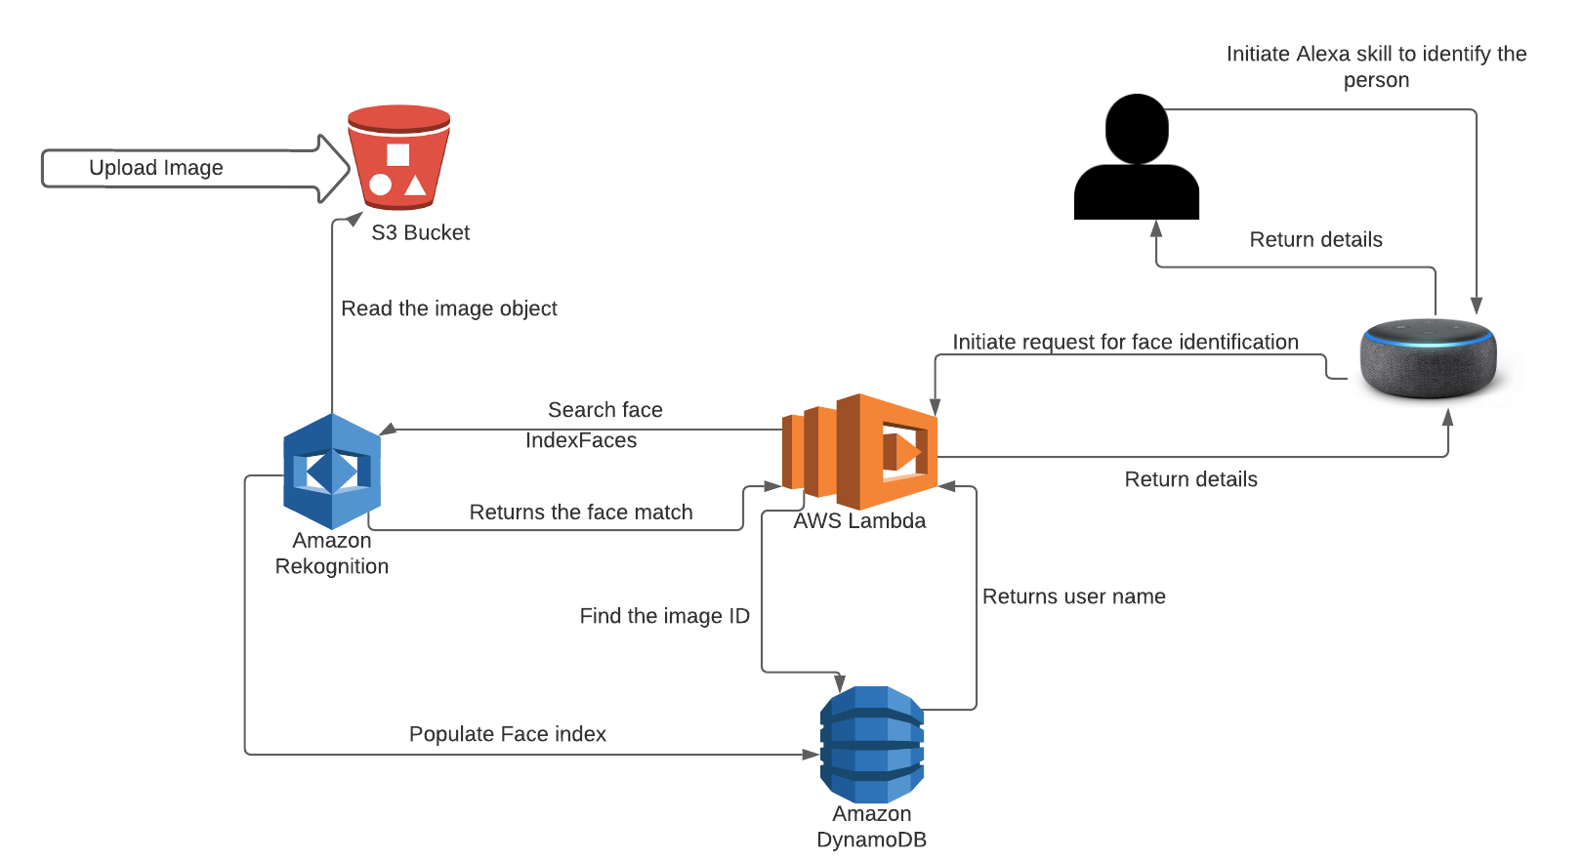
Implementation Architecture

Slide 13


ENTRA DEMO

Slide 14

How can we Secure Data?
Cloud Security Auditing- Determining if the information system and its maintainers are meeting both the legal expectations of protecting customer data and the company standards.
Proper Access Controls- Restrict the public access from using the our cloud services and data.
Encrypting the data- Transforming data into an unreadable form so that we can conceal it from malicious users.

Slide 15
Instant notifications through AWS SNS service.
Employee Attendance service for Corporate users.
Easy guest registration service for Corporate users.
Expand the functionality such as customizable Alexa skills based on customer requirements.
Interactive Front-end UI for the clients to manage the system efficiently.
Future Goals and Expectations

Slide 16

Questions?
Thank You!

